Slide 1
Basic Knowledge of Economic Signal
R12942126 游登智

Slide 2
Trading

Slide 3
The utility theory
Explain the relationship between investment risk and expected return.
You buy things or services, and they provide you with satisfaction.
Base on:
Economic conditions
Personal preferences
Risk preferences
Psychological factors
Environmental factors

Slide 4
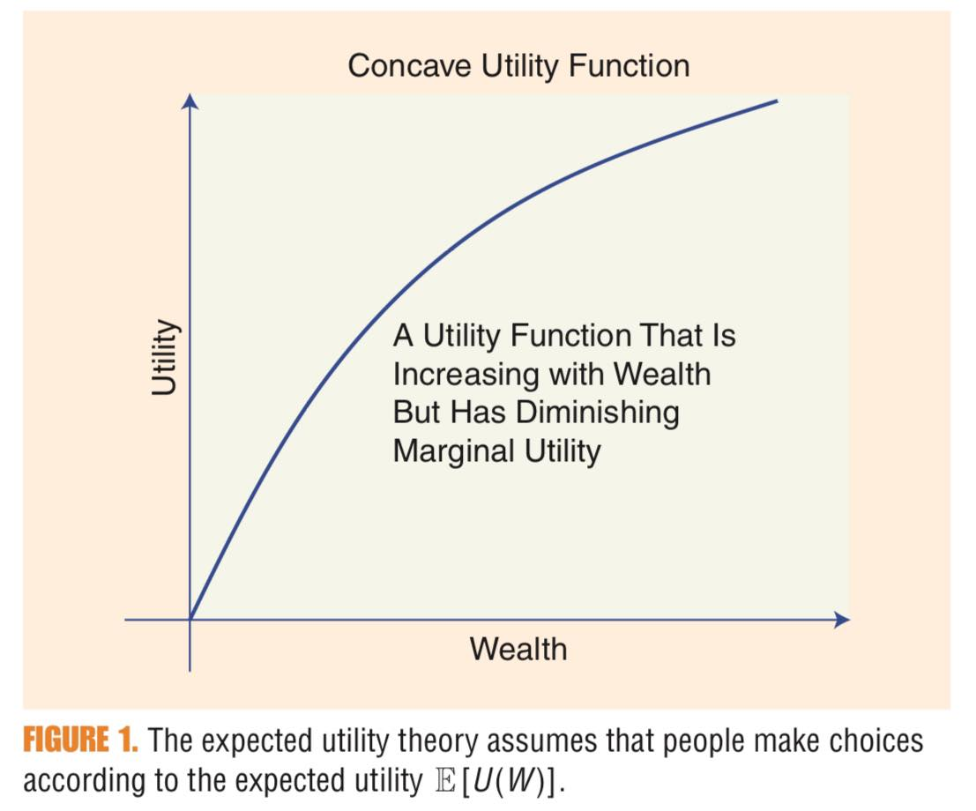
Concave utility function
Can be used in buying things, services, stock, and so on.
Diminishing Marginal Utility

Slide 5
Expected utility theory
It is a cornerstone for economics, game theory, and decision theory and pertains to people’s preferences.
In economics, the utility function $U(w)$is concave and increasing.

Slide 6
Expected utility theory
We assume a risk asset has two possible outcomes of wealth $w0$and $w1$ with equal probability, and $w0$ < $w1$. The expected wealth is
$E[W] = ½(w0 + w1)$.
The expected utility of this risk is
$E[U(W)] = ½(E\left[U\left(w0\right)\right]+E\left[\left(w1\right)\right])$.

Slide 7
Expected utility theory
The certain equivalent($CE$) is
$$CE = U−1 (E\left[\left(U\left(W\right)\right]\right).$$
The risk premium(RP) is
$RP = E[W] − CE$.

Slide 8
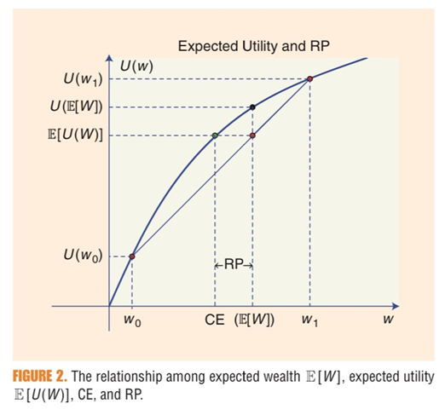
Expected utility theory
$CE$ represents guaranteed wealth whose utility is equivalent to that of the risk asset.
$$CE = U−1 (E[(U(W)] )$$
$RP$ is the amount of money that a person is willing to pay to eliminate risk.
$$RP = E[W] − CE$$

Slide 9
Price and Return
The price at time $t$ is $p$_{t}
The net return at time $t$ is
$dt$ is the dividend during the period $t−1$ to $t$, and if $dt$=0,

Slide 10
Log-Price and Log-Return
Log-price is
After taking log price, the volatility of the price is more stable, which helps to estimate risk and volatility more accurately.
Log-return is

Slide 11
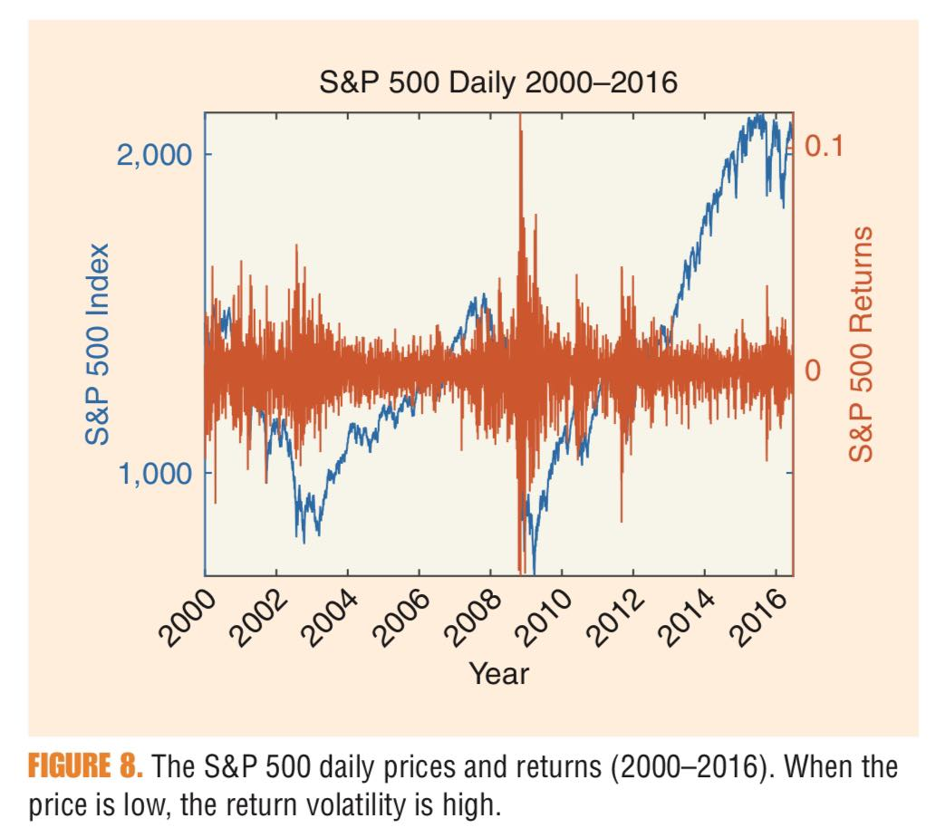
S&P 500

Slide 12
Portfolio
You have $100
You invest:
- 50% in stock A
25% in stock B
25% in stock C
The return on your portfolio is
where R_{A}, R_{B} and R_{C} is the return of each stock.

Slide 13
Mean-variance portfolio(MVP)
MVPs are the solution of the following mean-variance optimization criterion:
$$minimizew wTΣw$$
subject to $E[RP] = Σ wiE[Ri] =wTE[R] =re$
where $wT1=1$
$σRP2= ΣiΣjwiwjσij=wTΣw$

Slide 14
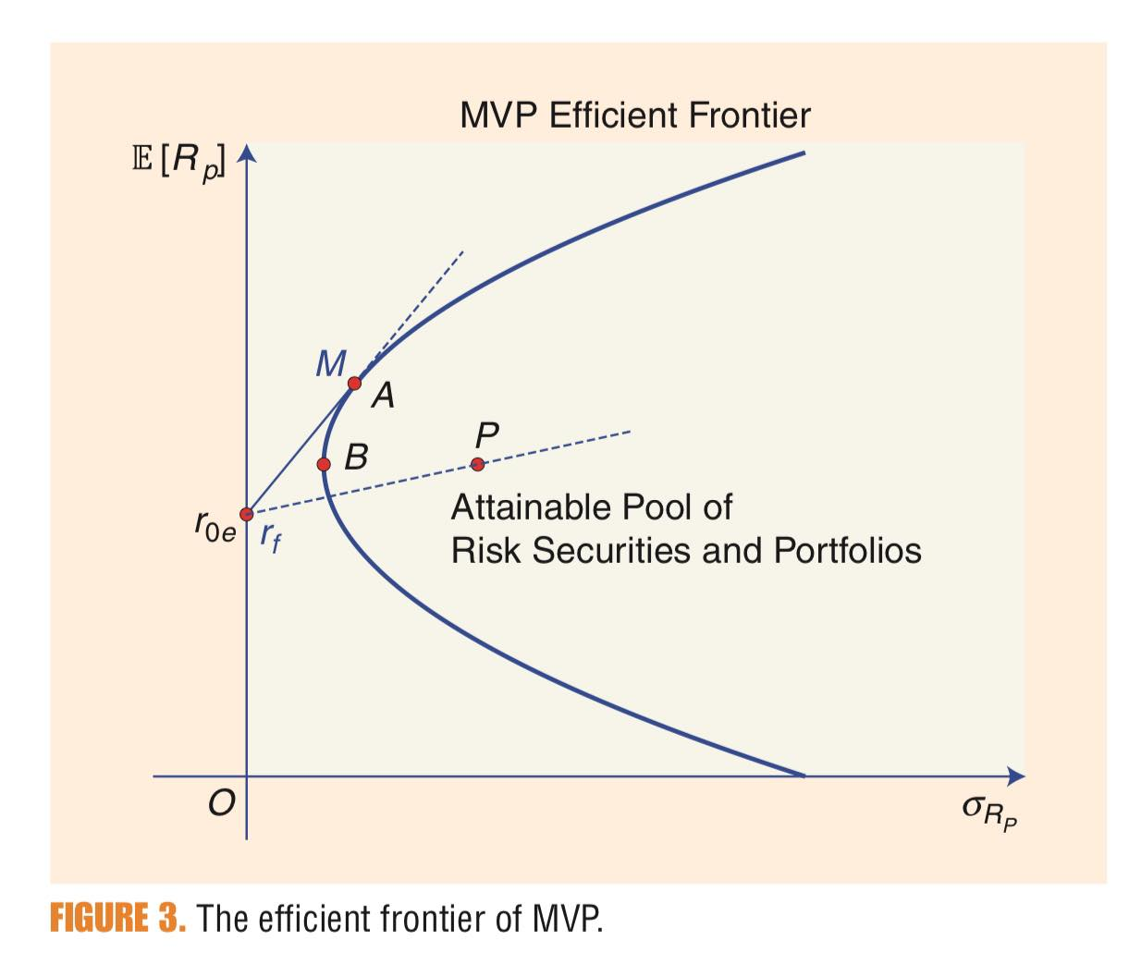
MVP efficient frontier
Ensure portfolio optimization and risk management.
Min Volatility Portfolio
B is the minimum-variance portfolio
Max Sharp Ratio Portfolio
Sharp Ratio $:SR= \frac{reward}{risk}$

Slide 15
Conclusion
With the above knowledge, we can further study economic-related signals.
Don’t put all eggs in one basket.

Slide 16
References
Zhang, X. P. S., & Wang, F. (2017). Signal processing for finance, economics, and marketing: concepts, framework, and big data applications. IEEE Signal Processing Magazine, 34(3), 14-35.

